Slide 1
Covid19
The Wuhan and SA Variants and Their Vaccines
Ady Stein, Ohad Edelstein, Ofir Nesher
April 2021

Slide 2
The Covid19 (Wuhan) virus

Slide 3
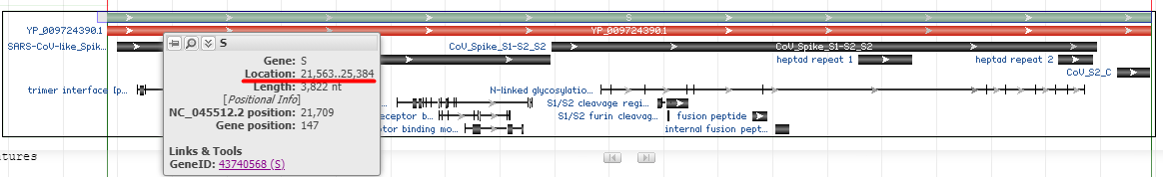
The (Wuhan Variant) Covid19 Virus
29,903 Nucleotides long
Out of which 3819 comprise the spike protein
Not including the end codon: UAA
Meaning 1273 amino acids (again not including the Stop)
Start codon AUG is at nucleotide 21,563 (21,562 zero based)
Has a GC content of 37.31%

Slide 4
The Vaccines

Slide 5
The Moderna Vaccine
4004 Nucleotides long
Out of which 3819 comprise the spike protein
Not including the end codon: UGA
Meaning 1273 amino acids (again not including the Stop)
Start codon AUG is at nucleotide 58 (57 zero based)
Has a GC content of 62.30%

Slide 6
The Pfizer Vaccine
4175 Nucleotides long
Out of which 3819 comprise the spike protein
Not including the end codon: UGA
Meaning 1273 amino acids (again not including the Stop)
Start codon AUG is at nucleotide 55 (54 zero based)
Has a GC content of 56.99%
So not identical on the nucleotide level to the Moderna vaccine
But identical on the amino acid level

Slide 7
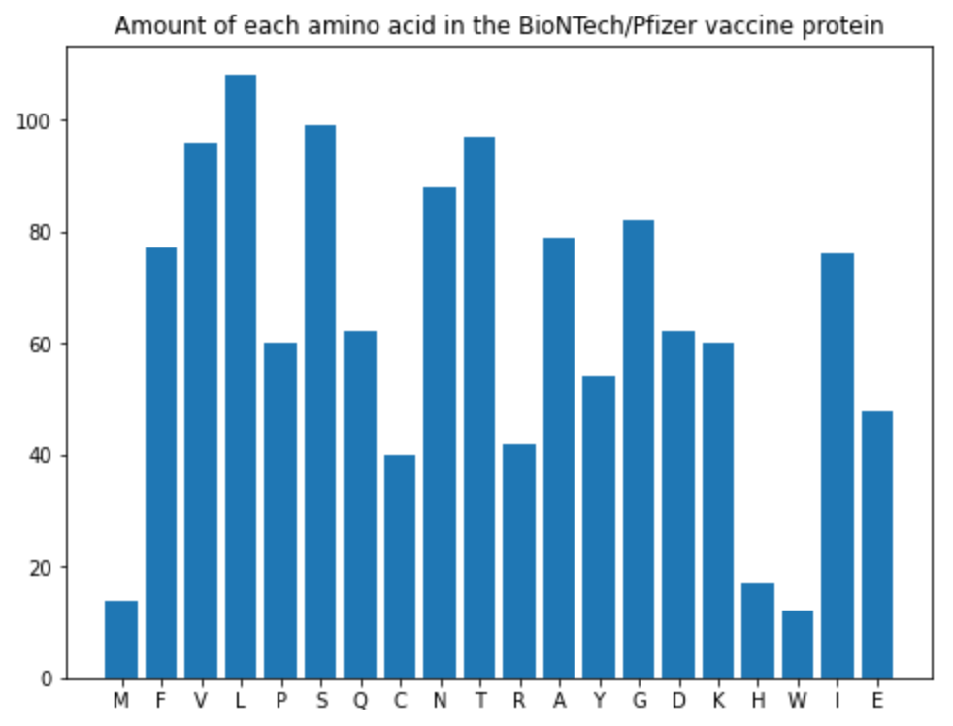
The Pfizer Vaccine
1273 amino acids (again not including the Stop)

Slide 8
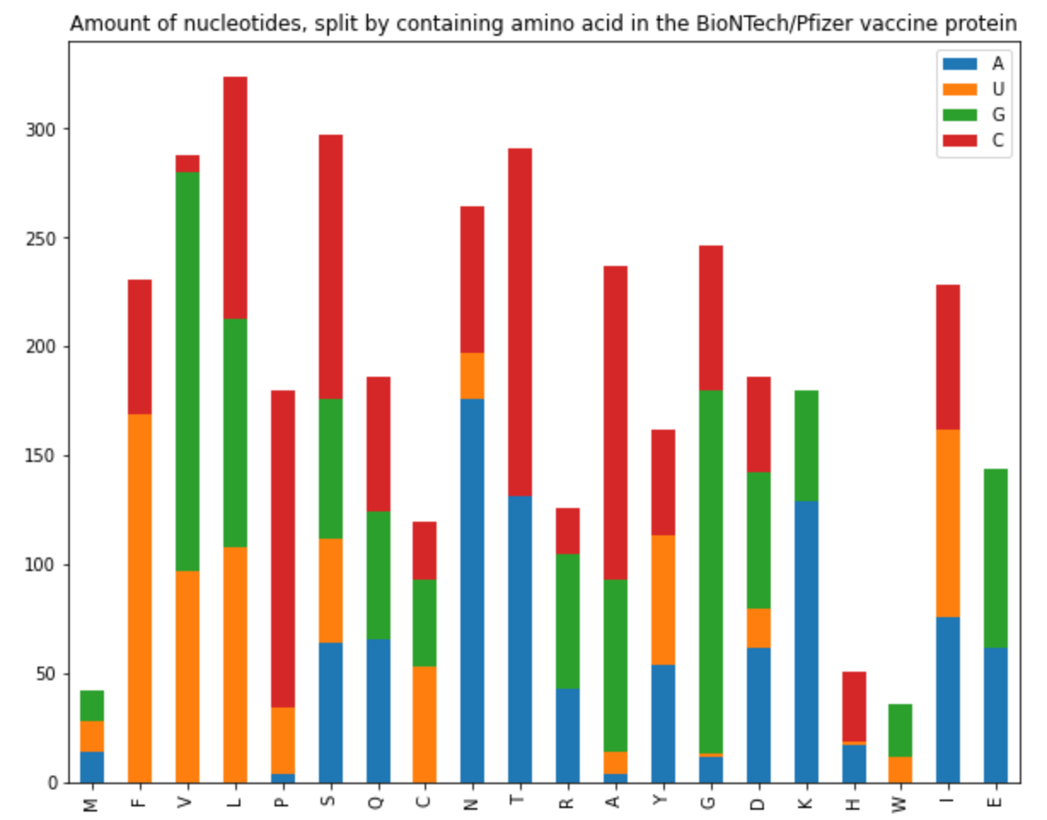
The Pfizer Vaccine
1273 amino acids (again not including the Stop)

Slide 9
The Pfizer Vaccine
Has a different GC content than the virus
56.99% (vaccine) vs 37.31% (virus)
So not identical at the nucleotide level to the virus
Why?
Nucleotides affect the secondary structure of the RNA molecule

Slide 10
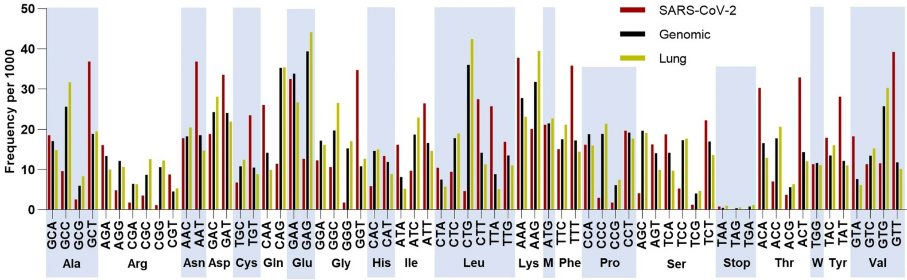
The Pfizer Vaccine
Why?
Nucleotides affect the secondary structure of the RNA molecule
“... viral codon usage often does not closely resemble the codon usage of their hosts, a phenomenon that is not well understood …”
* Source: https://www.nature.com/articles/s41598-020-72533-2

Slide 11
The Pfizer Vaccine
Why?
Nucleotides affect the secondary structure of the RNA molecule
“... viral codon usage often does not closely resemble the codon usage of their hosts, a phenomenon that is not well understood …”
“... it has been shown that viral attenuation can be achieved through extensive changes in codon pair usage of viral genes. … the mechanism of viral attenuation through codon pair deoptimization is not entirely clear ...”
“... In the case of the S protein, this may lead to decreased binding affinity for the ACE2 protein, thus affecting viral fitness.”
* Source: https://www.nature.com/articles/s41598-020-72533-2

Slide 12
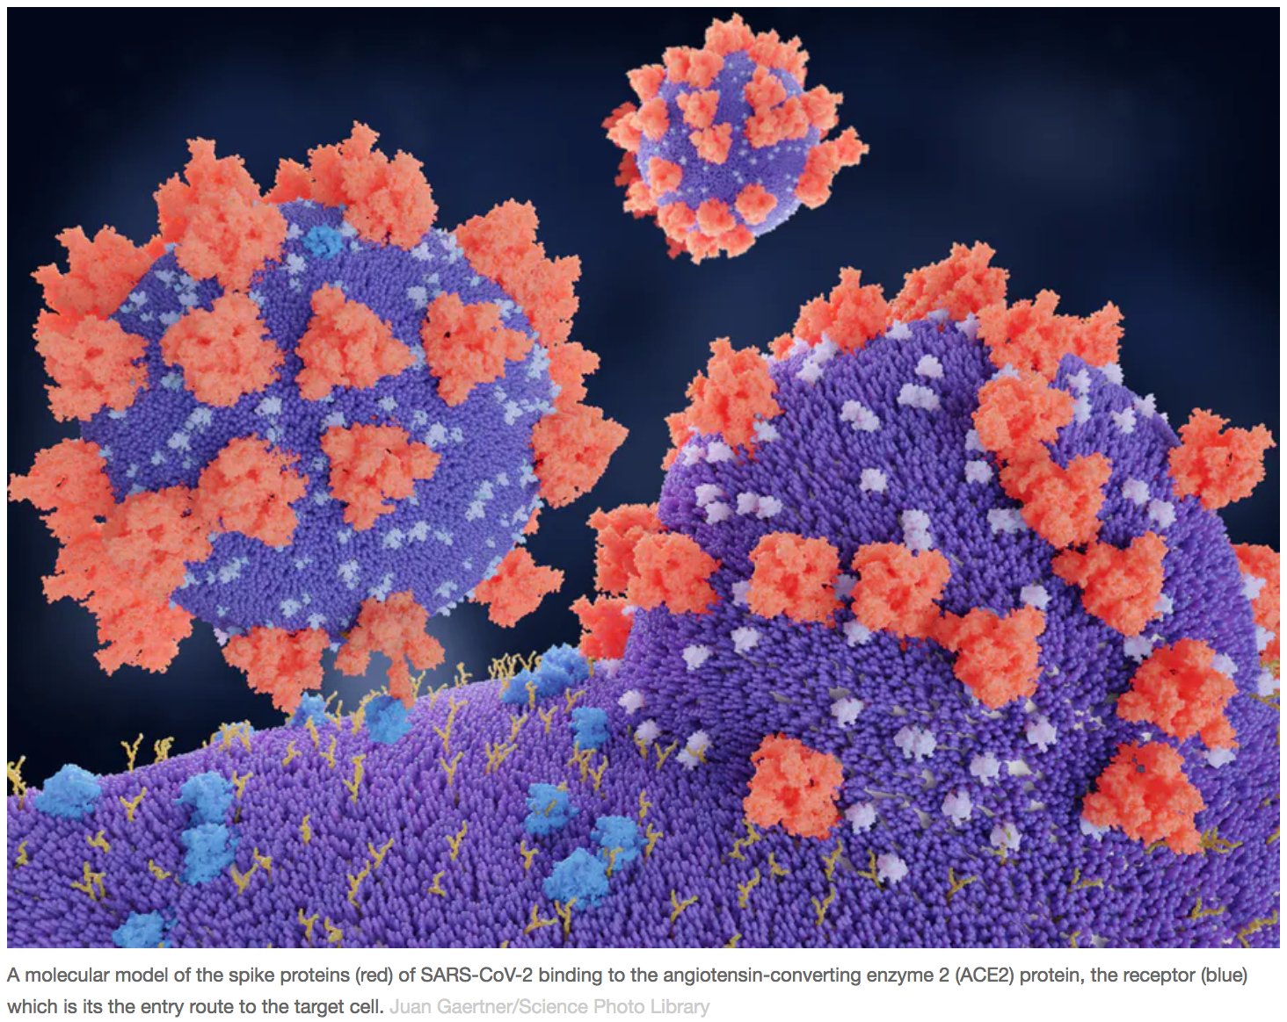
The Pfizer Vaccine
* Source: https://theconversation.com/what-is-the-ace2-receptor-how-is-it-connected-to-coronavirus-and-why-might-it-be-key-to-treating-covid-19-the-experts-explain-136928

Slide 13
The Pfizer Vaccine
Vac: Pfizer vaccine - Vir: Wuhan variant virus
=================================================================
Vac: MFVFLVLLPLVSSQCVNLTTRTQLPPAYTNSFTRGVYYPDKVFRSSVLHSTQDLFLPFFSNVTWFHAI
Vir: MFVFLVLLPLVSSQCVNLTTRTQLPPAYTNSFTRGVYYPDKVFRSSVLHSTQDLFLPFFSNVTWFHAI
Vac: HVSGTNGTKRFDNPVLPFNDGVYFASTEKSNIIRGWIFGTTLDSKTQSLLIVNNATNVVIKVCEFQFC
Vir: HVSGTNGTKRFDNPVLPFNDGVYFASTEKSNIIRGWIFGTTLDSKTQSLLIVNNATNVVIKVCEFQFC
Vac: NDPFLGVYYHKNNKSWMESEFRVYSSANNCTFEYVSQPFLMDLEGKQGNFKNLREFVFKNIDGYFKIY
Vir: NDPFLGVYYHKNNKSWMESEFRVYSSANNCTFEYVSQPFLMDLEGKQGNFKNLREFVFKNIDGYFKIY
Vac: SKHTPINLVRDLPQGFSALEPLVDLPIGINITRFQTLLALHRSYLTPGDSSSGWTAGAAAYYVGYLQP
Vir: SKHTPINLVRDLPQGFSALEPLVDLPIGINITRFQTLLALHRSYLTPGDSSSGWTAGAAAYYVGYLQP
Vac: RTFLLKYNENGTITDAVDCALDPLSETKCTLKSFTVEKGIYQTSNFRVQPTESIVRFPNITNLCPFGE
Vir: RTFLLKYNENGTITDAVDCALDPLSETKCTLKSFTVEKGIYQTSNFRVQPTESIVRFPNITNLCPFGE
Vac: VFNATRFASVYAWNRKRISNCVADYSVLYNSASFSTFKCYGVSPTKLNDLCFTNVYADSFVIRGDEVR
Vir: VFNATRFASVYAWNRKRISNCVADYSVLYNSASFSTFKCYGVSPTKLNDLCFTNVYADSFVIRGDEVR
Vac: QIAPGQTGKIADYNYKLPDDFTGCVIAWNSNNLDSKVGGNYNYLYRLFRKSNLKPFERDISTEIYQAG
Vir: QIAPGQTGKIADYNYKLPDDFTGCVIAWNSNNLDSKVGGNYNYLYRLFRKSNLKPFERDISTEIYQAG
Vac: STPCNGVEGFNCYFPLQSYGFQPTNGVGYQPYRVVVLSFELLHAPATVCGPKKSTNLVKNKCVNFNFN
Vir: STPCNGVEGFNCYFPLQSYGFQPTNGVGYQPYRVVVLSFELLHAPATVCGPKKSTNLVKNKCVNFNFN
Vac: GLTGTGVLTESNKKFLPFQQFGRDIADTTDAVRDPQTLEILDITPCSFGGVSVITPGTNTSNQVAVLY
Vir: GLTGTGVLTESNKKFLPFQQFGRDIADTTDAVRDPQTLEILDITPCSFGGVSVITPGTNTSNQVAVLY
Vac: QDVNCTEVPVAIHADQLTPTWRVYSTGSNVFQTRAGCLIGAEHVNNSYECDIPIGAGICASYQTQTNS
Vir: QDVNCTEVPVAIHADQLTPTWRVYSTGSNVFQTRAGCLIGAEHVNNSYECDIPIGAGICASYQTQTNS
Vac: PRRARSVASQSIIAYTMSLGAENSVAYSNNSIAIPTNFTISVTTEILPVSMTKTSVDCTMYICGDSTE
Vir: PRRARSVASQSIIAYTMSLGAENSVAYSNNSIAIPTNFTISVTTEILPVSMTKTSVDCTMYICGDSTE
Vac: CSNLLLQYGSFCTQLNRALTGIAVEQDKNTQEVFAQVKQIYKTPPIKDFGGFNFSQILPDPSKPSKRS
Vir: CSNLLLQYGSFCTQLNRALTGIAVEQDKNTQEVFAQVKQIYKTPPIKDFGGFNFSQILPDPSKPSKRS
Vac: FIEDLLFNKVTLADAGFIKQYGDCLGDIAARDLICAQKFNGLTVLPPLLTDEMIAQYTSALLAGTITS
Vir: FIEDLLFNKVTLADAGFIKQYGDCLGDIAARDLICAQKFNGLTVLPPLLTDEMIAQYTSALLAGTITS
Vac: GWTFGAGAALQIPFAMQMAYRFNGIGVTQNVLYENQKLIANQFNSAIGKIQDSLSSTASALGKLQDVV
Vir: GWTFGAGAALQIPFAMQMAYRFNGIGVTQNVLYENQKLIANQFNSAIGKIQDSLSSTASALGKLQDVV
Vac: NQNAQALNTLVKQLSSNFGAISSVLNDILSRLDPPEAEVQIDRLITGRLQSLQTYVTQQLIRAAEIRA
Vir: NQNAQALNTLVKQLSSNFGAISSVLNDILSRLDKVEAEVQIDRLITGRLQSLQTYVTQQLIRAAEIRA
^^
Vac: SANLAATKMSECVLGQSKRVDFCGKGYHLMSFPQSAPHGVVFLHVTYVPAQEKNFTTAPAICHDGKAH
Vir: SANLAATKMSECVLGQSKRVDFCGKGYHLMSFPQSAPHGVVFLHVTYVPAQEKNFTTAPAICHDGKAH
Vac: FPREGVFVSNGTHWFVTQRNFYEPQIITTDNTFVSGNCDVVIGIVNNTVYDPLQPELDSFKEELDKYF
Vir: FPREGVFVSNGTHWFVTQRNFYEPQIITTDNTFVSGNCDVVIGIVNNTVYDPLQPELDSFKEELDKYF
Vac: KNHTSPDVDLGDISGINASVVNIQKEIDRLNEVAKNLNESLIDLQELGKYEQYIKWPWYIWLGFIAGL
Vir: KNHTSPDVDLGDISGINASVVNIQKEIDRLNEVAKNLNESLIDLQELGKYEQYIKWPWYIWLGFIAGL
Vac: IAIVMVTIMLCCMTSCCSCLKGCCSCGSCCKFDEDDSEPVLKGVKLHYT
Vir: IAIVMVTIMLCCMTSCCSCLKGCCSCGSCCKFDEDDSEPVLKGVKLHYT
But what about the amino acids level?
Almost the same...

Slide 14
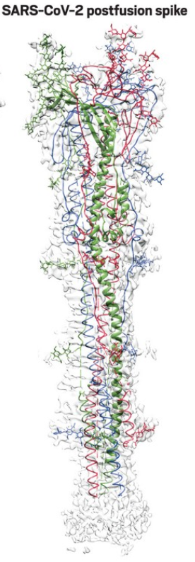
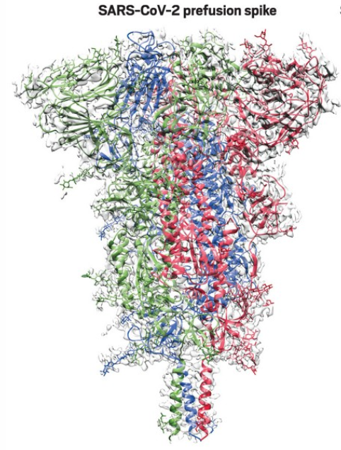
The Pfizer Vaccine
Why the different PP amino acids?
* Source: https://cen.acs.org/pharmaceuticals/vaccines/tiny-tweak-behind-COVID-19/98/i38

Slide 15
The SA virus variant

Slide 16
Create a vaccine
Mission

Slide 17
Process
Identify Candidate Samples
Cull
(meta based)
Find Spike
Cull
(spike based)
Create Vaccine
Try to find candidates based on 3 mutations, in non well-defined sites
Attempt to cull irrelevant entries, based on metadata we have on the initial candidates: country of origin, and collection date
Based on the starting sequence of amino acids of the spike protein, that all Covid19 variants seem to exhibit
Try to identify irrelevant samples, based on the properties of their spike proteins
Find the (mutated) spike sequence of the SA variant
Transform the nucleotides in a similar way to how the Wuhan vaccine was created
Append UTRs
Done?!

Slide 18
SA Variant - Identify Samples
Identify Candidate Samples
Cull
(meta based)
Find Spike
Cull
(spike based)
Create Vaccine
What we know
3 Mutations: G → A, A → T(U), A → C
Mutation sites, if the samples were aligned to the Wuhan variant
What we don’t know
The mutation sites in the non-aligned samples

Slide 19
SA Variant - Identify Samples
Identify Candidate Samples
Cull
(meta based)
Find Spike
Cull
(spike based)
Create Vaccine
Strategy:
Search for a sequence from the Wuhan variant that contains the mutation
E.g. if “GTTTGATAACC” in the Wuhan variant, search for “GTTTGCTAACC”
But, Q1: how big should the sequence around the mutation be?
Search in an area around the mutation site
E.g. search in: [ -100NT … MutationSiteInWuhan(A) … + 100NT ]
But, Q2: how big should the area we search in?
Mutation

Slide 20
SA Variant - Identify Samples
Identify Candidate Samples
Cull
(meta based)
Find Spike
Cull
(spike based)
Create Vaccine
Answer to both questions: Let’s try several options, and see if it affects the result
Searched sequence length | Size of area to search in | Samples found
Site ± 50NT (101 NT) | Site ± 300NT (601 NT) | 62
Site ± 50NT (101 NT) | Site ± 200NT (401 NT) | 62
Site ± 50NT (101 NT) | Site ± 100NT (201 NT) | 37
Site ± 20NT (41 NT) | Site ± 300NT (601 NT) | 62
Site ± 20NT (41 NT) | Site ± 200NT (401 NT) | 62
Site ± 20NT (41 NT) | Site ± 100NT (201 NT) | 62
Site ± 10NT (21 NT) | Site ± 300NT (601 NT) | 64
Site ± 10NT (21 NT) | Site ± 200NT (401 NT) | 64
Site ± 10NT (21 NT) | Site ± 100NT (201 NT) | 64
Site ± 5NT (11 NT) | Site ± 300NT (601 NT) | 64
Site ± 5NT (11 NT) | Site ± 200NT (401 NT) | 64
Site ± 5NT (11 NT) | Site ± 100NT (201 NT) | 64
Maximum 64 samples
Same 64 samples, or a subset
If we search for a sequence that’s long compared to the region we are looking in, some samples will be dropped

Slide 21
SA Variant - Cull Samples by Metadata
Identify Candidate Samples
Cull
(meta based)
Find Spike
Cull
(spike based)
Create Vaccine
SA variant samples by country:
----------------------------------------------------------
United States of America (56)
MW912490.1, MW913437.1, MW914008.1, MW914015.1, MW914445.1
MW914542.1, MW905790.1, MW905844.1, MW905875.1, MW906028.1
MW906061.1, MW907199.1, MW907323.1, MW908243.1, MW908815.1
MW909222.1, MW909347.1, MW898265.1, MW883160.1, MW877177.1
MW880890.1, MW869153.1, MW844243.1, MW844258.1, MW844743.1
MW847393.1, MW849825.1, MW795351.1, MW842292.1, MW807936.1
MW808030.1, MW808712.1, MW809047.1, MW803575.1, MW803586.1
MW793569.1, MW796654.1, MW796843.1, MW792684.1, MW792756.1
MW793005.1, MW773815.1, MW763124.1, MW763125.1, MW763126.1
MW763127.1, MW763128.1, MW763129.1, MW763130.1, MW763131.1
MW763132.1, MW687146.1, MW617734.1, MW621453.1, MW580574.1
MW580576.1
Ghana (3)
MW598408.1, MW598413.1, MW598419.1
United Kingdom (2)
HG999935.1, HG999939.1
Germany (1)
MW822592.1
Italy (1)
MW789246.1
France (1)
MW580244.1
SA variant samples by collection month*:
----------------------------------------------------------
2021-03 (29)
MW912490.1, MW913437.1, MW914008.1, MW914015.1, MW914445.1
MW914542.1, MW905790.1, MW905844.1, MW905875.1, MW906028.1
MW906061.1, MW907199.1, MW907323.1, MW908243.1, MW908815.1
MW909222.1, MW909347.1, MW898265.1, MW883160.1, MW877177.1
MW880890.1, MW869153.1, MW847393.1, MW849825.1, MW795351.1
MW808712.1, MW809047.1, MW796843.1, MW789246.1
2021-02 (26)
MW844243.1, MW844258.1, MW844743.1, MW842292.1, MW807936.1
MW808030.1, MW803575.1, MW803586.1, MW793569.1, MW796654.1
MW792684.1, MW792756.1, MW793005.1, MW773815.1, MW763124.1
MW763125.1, MW763126.1, MW763127.1, MW763128.1, MW763129.1
MW763130.1, MW763131.1, MW763132.1, MW687146.1, MW621453.1
MW580576.1
2021-01 (7)
MW822592.1, MW580244.1, MW617734.1, MW598408.1, MW598413.1
MW598419.1, MW580574.1
Nothing suspicious...
* Two samples (from the UK), had no collection date

Slide 22
SA Variant - Find Spike
Identify Candidate Samples
Cull
(meta based)
Find Spike
Cull
(spike based)
Create Vaccine
Search for a sequence that the Wuhan variant has at the beginning
Problems that might arise:
Sequence is too short: More than one finding per sample (false-positives)
Sequence is too long: Can’t find the spike in all samples (false-negatives)

Slide 23
SA Variant - Find Spike
Identify Candidate Samples
Cull
(meta based)
Find Spike
Cull
(spike based)
Create Vaccine
Searched for:
AUGUUUGUUUUUCUUGUUUUAUUGCCACUAGUCUCUAGUCAGUGUGUUAAUCUUACAACCAGAACUCAAUUACCCCCUGCAUACACUAAUUCUUUCACACGU
A match could not be found in some of the samples
Searched for:
AUGUUUGUUUUUCUUGUUUUAUUGCCACUAGUCU
Exactly one match was found in every sample

Slide 24
SA Variant - Cull Samples by Spike Protein Properties
Identify Candidate Samples
Cull
(meta based)
Find Spike
Cull
(spike based)
Create Vaccine
Found some fundamental differences between aminos:
Some samples have sequencing ambiguities (i.e. X/Z/B/J amino acids)
2 distinct lengths of the spike protein were found
We took 3 main different approaches:
Ignore all samples that have any sequencing ambiguities
Select samples by length
According to a paper that describes the SA variant mutations
(also tried to look at the end codon, but all were the same: UAA)

Slide 25
SA Variant - Cull Samples by Spike Protein Properties
Identify Candidate Samples
Cull
(meta based)
Find Spike
Cull
(spike based)
Create Vaccine
Approach 1: Ignore all samples that have any sequencing ambiguities
After removing all samples with ambiguities, we were left with 35 samples, that have 10 distinct spike protein sequences (on the amino acid level)
Only one of the samples was longer than the rest by 3 (LAL) amino acids (L242_244L)
The Wuhan strain also contains the “extra” amino acids, so we assumed it is a differentiating feature, and removed that sample as well - leaving 34 samples (9 proteins)
As not all 34 samples “agreed” on what amino acid exists at every position, we used majority vote to decide what the amino acid should be, then a majority vote between the “winners”, to decide the about the nucleotides
Identified 7 additional mutations (in addition to L242_244L)

Slide 26
SA Variant - Cull Samples by Spike Protein Properties
Identify Candidate Samples
Cull
(meta based)
Find Spike
Cull
(spike based)
Create Vaccine
Approach 1: Ignore all samples that have any sequencing ambiguities
MFVFLVLLPLVSSQCVNLTTRTQLPPAYTNSFTRGVYYPDKVFRSSVLHSTQDLFLPFFSNVTWFHAIHVSGTNGTKRFANPVLPFNDGVYFASTEKSNIIRGWIFGTTLDSKTQSLLIVNNATNVVIKVCEFQFC
MFVFLVLLPLVSSQCVNLTTRTQLPPAYTNSFTRGVYYPDKVFRSSVLHSTQDLFLPFFSNVTWFHAIHVSGTNGTKRFANPVLPFNDGVYFASTEKSNIIRGWIFGTTLDSKTQSLLIVNNATNVVIKVCEFQFC
MFVFLVLLPLVSSQCVNFTTRTQLPPAYTNSFTRGVYYPDKVFRSSVLHSTQDLFLPFFSNVTWFHAIHVSGTNGTKRFANPVLPFNDGVYFASTEKSNIIRGWIFGTTLDSKTQSLLIVNNATNVVIKVCEFQFC
MFVFLVLLPLVSSQCVNLTTRTQLPPAYTNSFTRGVYYPDKVFRSSVLHSTQDLFLPFFSNVTWFHAIHVSGTNGTKRFANPVLPFNDGVYFASTEKSNIIRGWIFGTTLDSKTQSLLIVNNATNVVIKVCEFQFC
MFVFLVLLPLVSSQCVNFTTRTQLPPAYTNSFTRGVYYPDKVFRSSVLHSTQDLFLPFFSNVTWFHAIHVSGTNGTKRFANPVLPFNDGVYFASTEKSNIIRGWIFGTTLDSKTQSLLIVNNATNVVIKVCEFQFC
MFVFLVLLPLVSSQCVNLITRTQLPPAYTNSFTRGVYYPDKVFRSSVLHSTQDLFLPFFSNVTWFHAIHVSGTNGTKRFANPVLPFNDGVYFASTEKSNIIRGWIFGTTLDSKTQSLLIVNNATNVVIKVCEFQFC
MFVFLVLLPLVSSQCVNLTTRTQLPPAYTNSFTRGVYYPDKVFRSSVLHSTQDLFLPFFSNVTWFHAIHVSGTNGTKRFANPVLPFNDGVYFASTEKSNIIRGWIFGTTLDSKTQSLLIVNNATNVVIKVCEFQFC
MFVFLVLLPLVSSQCVNFTTRTQLPPAYTNSFTRGVYYPDKVFRSSVLHSTQDLFLPFFSNVTWFHAIHVSGTNGTKRFANPVLPFNDGVYFASTEKSNIIRGWIFGTTLDSKTQSLLIVNNATNVVIKVCEFQFC
MFVFLVLLPLVSSQCVNLTTRTQLPPAYTNSFTRGVYYPDKVFRSSVLHSTQDLFLPFFSNVTWFHAIHVSGTNGTKRFANPVLPFNDGVYFASTEKSNIIRGWIFGTTLDSKTQSLLIVNNATNVVIKVCEFQFC
MFVFLVLLPLVSSQCVNLTTRTQLPPAYTNSFTRGVYYPDKVFRSSVLHSTQDLFLPFFSNVTWFHAIHVSGTNGTKRFANPVLPFNDGVYFASTEKSNIIRGWIFGTTLDSKTQSLLIVNNATNVVIKVCEFQFC
^^
NDPFLGVYYHKNNKSWMESEFRVYSSANNCTFEYVSQPFLMDLEGKQGNFKNLREFVFKNIDGYFKIYSKHTPINLVRGLPQGFSALEPLVDLPIGINITRFQTL HRSYLTPGDSSSGWTAGAAAYYVGYLQP
NDPFLGVYYHKNNKSWMESEFRVYSSANNCTFEYVSQPFLMDLEGKQGNFKNLREFVFKNIDGYFKIYSKHTPINLVRGLPQGFSALEPLVDLPIGINITKFQTL HRSYLTPGDSSSGWTAGAAAYYVGYLQP
NDPFLGVYYHKNNKSWMESEFRVYSSANNCTFEYVSQPFLMDLEGKQGNFKNLREFVFKNIDGYFKIYSKHTPINLVRGLPQGFSALEPLVDLPIGINITRFQTL HRSYLTPGDSSSGWTAGAAAYYVGYLQP
NDPFLGVYYHKNNKSWMESEFRVYSSANNCTFEYVSQPFLMDLEGKQGNFKNLREFVFKNIDGYFKIYSKHTPINLVRGLPQGFSALEPLVDLPIGINITRFQTL HRSYLTPGDSSSGWTAGAAAYYVGYLQP
NDPFLGVYYHKNNKSWMESEFRVYSSANNCTFEYVSQPFLMDLEGKQGNFKNLREFVFKNIDGYFKIYSKHTPINLVRGLPQGFSALEPLVDLPIGINITRFQTL HRSYLTPGDSSSGWTAGAAAYYVGYLQP
NDPFLGVYYHKNNKSWMESEFRVYSSANNCTFEYVSQPFLMDLEGKQGNFKNLREFVFKNIDGYFKIYSKHTPINLVRGLPQGFSALEPLVDLPIGINITRFQTL HRSYLTPGDSSSGWTAGAAAYYVGYLQP
NDPFLGVYYHKNNKSWMESEFRVYSSANNCTFEYVSQPFLMDLEGKQGNFKNLREFVFKNIDGYFKIYSKHTPINLVRGLPQGFSALEPLVDLPIGINITRFQTL HRSYLTPGDSSSGWTAGAAAYYVGYLQP
NDPFLGVYYHKNNKSWMESEFRVYSSANNCTFEYVSQPFLMDLEGKQGNFKNLREFVFKNIDGYFKIYSKHTPINLVRGLPQGFSALEPLVDLPIGINITRFQTL HRSYLTPGDSSSGWSAGAAAYYVGYLQP
NDPFLGVYYHKNNKSWMESEFRVYSSANNCTFEYVSQPFLMDLEGKQGNFKNLREFVFKNIDGYFKIYSKHTPINLVRGLPQGFSALEPLVDLPIGINITRFQTLLALHRSYLTPGDSSSGWTAGAAAYYVGYLQP
NDPFLGVYYHKNNKSWMESEFRVYSSANNCTFEYVSQPFLMDLEGKQGNFKNLREFVFKNIDGYFKIYSKHTPINLVRGLPQGFSALEPLVDLPIGINITRFQTL HRSYLTPGDSSSGWTAGAAAYYVGYLQP
^ ^^^ ^
RTFLLKYNENGTITDAVDCALDPLSETKCTLKSFTVEKGIYQTSNFRVQPTESIVRFPNITNLCPFGEVFNATRFASVYAWNRKRISNCVADYSVLYNSASFSTFKCYGVSPTKLNDLCFTNVYADSFVIRGDEVR ...
RTFLLKYNENGTITDAVDCALDPLSETKCTLKSFTVEKGIYQTSNFRVQPTESIVRFPNITNLCPFGEVFNATRFASVYAWNRKRISNCVADYSVLYNSASFSTFKCYGVSPTKLNDLCFTNVYADSFVIRGDEVR ...
RTFLLKYNENGTITDAVDCALDPLSETKCTLKSFTVEKGIYQTSNFRVQPTESIVRFPNITNLCPFGEVFNATRFASVYAWNRKRISNCVADYSVLYNSASFSTFKCYGVSPTKLNDLCFTNVYADSFVIRGDEVR ...
RTFLLKYNENGTITDAVDCALDPLSETKCTLKSFTVEKGIYQTSNFRVQPTESIVRFPNITNLCPFGEVFNATRFASVYAWNRKRISNCVADYSVLYNSASFSTFKCYGVSPTKLNDLCFTNVYADSFVIRGDEVR ...
RTFLLKYNENGTITDAVDCALDPLSETKCTLKSFTVEKGIYQTSNFRVQPTESIVRFPNITNLCPFGEVFNATRFASVYAWNRKRISNCVADYSVLYNSASFSTFKCYGVSPTKLNDLCFTNVYADSFVIRGDEVR ...
RTFLLKYNENGTITDAVDCALDPLSETKCTLKSFTVEKGIYQTSNFRVQPTESIVRFPNITNLCPFGEVFNATRFASVYAWNRKRISNCVADYSVLYNSASFSTFKCYGVSPTKLNDLCFTNVYADSFVIRGDEVR ...
RTFLLKYNENGTITDAVDCALDPLSETKCTLKSFTVEKGIYQTSNFRVQPTESIVRFPNITNLCPFGEVFNATRFASVYAWNRKRISNCVADYSVLYNSASFSTFKCYGVSPTKLNDLCFTNVYADSFVIRGDEVR ...
RTFLLKYNENGTITDAVDCALDPLSETKCTLKSFTVEKGIYQTSNFRVQPTESIVRFPNITNLCPFGEVFNATRFASVYAWNRKRISNCVADYSVLYNSASFSTFKCYGVSPTKLNDLCFTNVYADSFVIRGDEVR ...
RTFLLKYNENGTITDAVDCALDPLSETKCTLKSFTVEKGIYQTSNFRVQPTESIVRFPNITNLCPFGEVFNATRFASVYAWNRKRISNCVADYSVLYNSASFSTFKCYGVSPTKLNDLCFTNVYADSFVIRGDEVR ...
RTFLLKYNENGTITDAVDCALDPLSETKCTLKSFTVEKGIYQTSNFRVQPTESIVRFPNITNLCPFGEVFNATRFASVYAWNRKRISNCVADYSVLYNSASFSTFKCYGVSPTKLNDLCFTNVYADSFVIRGDEVR ...

Slide 27
SA Variant - Cull Samples by Spike Protein Properties
Identify Candidate Samples
Cull
(meta based)
Find Spike
Cull
(spike based)
Create Vaccine
Approach 2: Select samples by length
Previous approach was “safe” but wasteful - wanted to try and use all samples, and only ignore sequencing ambiguities on the majority vote stages
In practice, found that there are still 2 distinct lengths of the spike protein, however not 100% sure all “longer” sequences contain L242_244L, as the region is occluded by sequencing ambiguities
Decided to cull the longer sequences (based on previous intuition): 55 samples remained
Again majority vote to decide the amino acid at each point, then the nucleotides
The result was identical to the previous approach

Slide 28
SA Variant - Cull Samples by Spike Protein Properties
Identify Candidate Samples
Cull
(meta based)
Find Spike
Cull
(spike based)
Create Vaccine
Approach 2: Select samples by length
1 … NDPFLGVYYHKNNKSWMESEFRVYSSANNCTFEYVSQPFLMDLEGKQGNFKNLREFVFKNIDGYFKIYSKHTPINLVRGLPQGFSALEPLVDLPIGINITRFQTLHRSYLTPGDSSSGWTAGAAAXXXGYLQPRTF …
18 … NDPFLGVYYHKNNKSWMESEFRVYSSANNCTFEYVSQPFLMDLEGKQGNFKNLREFVFKNIDGYFKIYSKHTPINLVRGLPQGFSALEPLVDLPIGINITRFQTLHRSYLTPGDSSSGWTAGAAAYYVGYLQPRTF …
1 … NDPFLGVYYHKNNKSWMESEFRVYSSANNCTFEYVSQPFLMDLEGKQGNFKNLREFVFKNIDGYFKIYSKHTPINLVRGLPQGFSALEPLVDLPIGINITKFQTLHRSYLTPGDSSSGWTAGAAAYYVGYLQPRTF …
8 … NDPFLGVYYHKNNKSWMESEFRVYSSANNCTFEYVSQPFLMDLEGKQGNFKNLREFVFKNIDGYFKIYSKHTPINLVRGLPQGFSALEPLVDLPIGINITRFQTLHRSYLTPGDSSSGWTAGAAAYYVGYLQPRTF …
1 … NDPFLGVYYHKNNKSWMESEFRVYSSANNCTFEYVSQPFLMDLEGKQGNFKNLREFVFKNIDGYFKIYSKHTPINLVRGLPQGFSALEPLVDLPIGINITRFQTLHRSYLTPGDSXXXXXXXXXXXXXXXXXXXXX …
2 … NDPFLGVYYHKNNKSWMESEFRVYSSANNCTFEYVSQPFLMDLEGKQGNFKNLREFVFKNIDGYFKIYSKHTPINLVRGLPQGFSALEPLVDLPIGINITRFQTLHRSYLTPGDSXXXXXXXXXXXXXXXXXXXXX …
1 … NDPFLGVYYHKNNKSWMESEFRVYSSANNCTFEYVSQPFLMDLEGKQGNFKNLREFVFKNIDGYFKIYSKHTPINLVRGLPQGFSALEPLVDLPIGINITRFQTLHRSYLTPGDSSSGWTAGAAAYYVGYLQPRTF …
1 … NDPFLGVYYHKNNKSWMESEFRVYSSANNCTFEYVSQPFLMDLEGKQGNFKNLREFVFKNIDGYFKIYSKHTPINLVRGLPQGFSALEPLVDLPIGINITRFQTLHRSYLTPGDSSSGWTXXXAAYYVGXLQPRTF …
1 … NDPFLGVYYHKNNKSWMESEFRVYSSANNCTFEYVSQPFLMDLEGKQGNFKNLREFVFKNIDGYFKIYSKHTPINLVRGLPQGFSALEPLVDLPIGINITRFQTLHRSYLTPGDSSSGWTXXXXXYYVGYLQPRTF …
1 … NDPFLGVYYHKNNKSWMESEFRVYSSANNCTFEYVSQPFLMDLEGKQGNFKNLREFVFKNIDGYFKIYSKHTPINLVRGLPQGFSALEPLVDLPIGINITRFQTLHRSYLTPGDSSSGWTAGAAAYYVGYLQXXXX …
1 … NDPFLGVYYHKNNKSWMESEFRVYSSANNCTFEYVSQPFLMDLEGKQGNFKNLREFVFKNIDGYFKIYSKHTPINLVRGLPQGFSALEPLVDLPIGINITRFQTLHRSYLTPGDSSSGWTAGXXXXXXXXXXXXXX …
1 … NDPFLGVYYHKNNKSWMESEFRVYSSANNCTFEYVSQPFLMDLEGKQGNFKNLREFVFKNIDGYFKIYSKHTPINLVRGLPQGFSALEPLVDLPIGINITRFQTLHRSYLTPGDSSSGWTAGXXXXXXGXXXXXXX …
1 … NDPFLGVYYHKNNKSWMESEFRVYSSANNCTFEYVSQPFLMDLEGKQGNFKNLREFVFKNIDGYFKIYSKHTPINLVRGLPQGFSALEPLVDLPIGINITRFQTLHRSYLTPGDSSSGWTAGAAAYYVGYLQPRTF …
3 … NDPFLGVYYHKNNKSWMESEFRVYSSANNCTFEYVSQPFLMDLEGKQGNFKNLREFVFKNIDGYFKIYSKHTPINLVRGLPQGFSALEPLVDLPIGINITRFQTLHRSYLTPGDSXXXXXXXXXXXXXXXXXXXXX …
1 … NDPFLGVYYHKNNKSWMESEFRVYSSANNCTFEYVSQPFLMDLEGKQGNFKNLREFVFKNIDGYFKIYSKHTPINLVRGLPQGFSALEPLVDLPIGINITRFQTLHRSYLTPGDSSSGWTAGAAAYYVGYLQPRTF …
1 … NDPFLGVYYHKNNKSWMESEFRVYSSANNCTFEYVSQPFLMDLEGKQGNFKNLREFVFKNIDGYFKIYSKHTPINLVRGLPQGFSALEPLVDLPIGINITRFQTLHRSYLTPGDSSSGWTAGAAAYYVGYLQPRTF …
1 … NDPFLGVYYHKNNKSWMESEFRVYSSANNCTFEYVSQPFLMDLEGKQGNFKNLREFVFKNIDGYFKIYSKHTPINLVRGLPQGFSALEPLVDLPIGINITRFQTLHRSYLTPGDSSSGWTAGAAAYYVGYLQPRTF …
1 … NDPFLGVYYHKNNKSWMESEFRVYSSANNCTFEYVSQPFLMDLEGKQGNFKNLREFVFKNIDGYFKIYSKHTPINLVRGLPQGFSALEPLVDLPIGINITRFQTLHRSYLTPGDSSSGWTAGAAAYYVGXXQPRTF …
1 … NDPFLGVYYHKNNKSWMESEFRVYSSANNCTFEYVSQPFLMDLEGKQGNFKNLREFVFKNIDGYFKIYSKHTPINLVRGLPQGFSALEPLVDLPIGINITRFQTLHRSYLTPGDSSSGWTAGAAAYYVGYLQPRTF …
2 … NDPFLGVYYHKNNKSWMESEFRVYSSANNCTFEYVSQPFLMDLEGKQGNFKNLREFVFKNIDGYFKIYSKHTPINLVRGLPQGFSALEPLVDLPIGINITRFQTLHRSYLTPGDSSSGWTAGAAAYYVGYLQPRTF …
1 … NDPFLGVYYHKNNKSWMESEFRVYSSANNCTFEYVSQPFLMDLEGKQGNFKNLREFVFKNIDGYFKIYSKHTPINLVRGLPQGFSALEPLVDLPIGINITRFQTLHRSYLTPGDSSSGWTXGAAAYYVGYLQPRTF …
1 … NDPFLGVYYHKNNKSWMESEFRVYSSANNCTFEYVSQPFLMDLEGKQGNFKNLREFVFKNIDGYFKIYSKHTPINLVRGLPQGFSALEPLVDLPIGINITRFQTLHRSYLTPGDSSSGWTAGAAAYYVGYLQPRTF …
1 … NDPFLGVYYHKNNKSWMESEFRVYSSANNCTFEYVSQPFLMDLEGKQGNFKNLREFVFKNIDGYFKIYSKHTPINLVRGLPQGFSALEPLVDLPIGINITRFQTLHRSYLTPGDSSSGWSAGAAAYYVGYLQPRTF …
1 … NDPFLGVYYHKNNKSWMESEFRVYSSANNCTFEYVSQPFLMDLEGKQGNFKNLREFVFKNIDGYFKIYSKHTPINLVRGLPQGFSALEPLVDLPIGINITRFQTLHRSYLTPGDSSSGWTAXXXXXXXXXXXXXXX …
1 … NDPFLGVYYHKNNKSWMESEFRVYSSANNCTFEYVSQPFLMDLEGKQGNFKNLREFVFKNIDGYFKIYSKHTPINLVRGLPQGFSALEPLVDLPIGINITRFQTLHRSYLTPGDSSSGWTAGAAAYYVGYLQPRTF …
1 … NDPFLGVYYHKNNKSWMESEFRVYSSANNCTFEYVSQPFLMDLEGKQGNFKNLREFVFKNIDGYFKIYSKHTPINLVRGLPQGFSALEPLVDLPIGINITRFQTLHRSYLTPGDSSSGWTAGAAAYYVGYLQPRTF …
1 … NDPFLGVYYHKNNKSWMESEFRVYSSANNCTFEYVSQPFLMDLEGKQGNFKNLREFVFKNIDGYFKIYSKHTPINLVRGLPQGFSALEPLVDLPIGINITRFQTLHRSYLTPGDSSSGWTAGAAAYYVGYLQPRTF …
R T

Slide 29
SA Variant - Cull Samples by Spike Protein Properties
Identify Candidate Samples
Cull
(meta based)
Find Spike
Cull
(spike based)
Create Vaccine
Approach 3: According to a paper* that describes the SA variant’s mutations
The paper identifies 6 mutations that were present since the first sampling of the SA variant: D614G, D80A, D215G, E484K, N501Y, A701V, and 3 more that evolved at a later stage: L18F, R246I, K417N
The E484K was only found to be present in <0.02% of the samples outside of SA
9 samples contained the E484K mutation, and the same 9 also contained the other 5 “early” mutations, and 1 of the “later” mutations (7 in total), but none had all 9 mutations
All 9 samples were of the “longer” kind: 1 clearly exhibited L242_244L, but on the other 8, it was at least partially occluded by sequencing ambiguities
* Source: https://www.medrxiv.org/content/10.1101/2020.12.21.20248640v1.full-text

Slide 30
SA Variant - Cull Samples by Spike Protein Properties
Identify Candidate Samples
Cull
(meta based)
Find Spike
Cull
(spike based)
Create Vaccine
Approach 3: According to a paper* that describes the SA variant’s mutations
The 9 samples were identical on the amino acid level, excluding ambiguities
Excluding L242_244L, the 7 mutations that were found, were also found by previous approaches
The 7 mutations were only found on 9 samples, as all other 55 samples are shorter, thus any mutation appearing after L242_244L would appear in a different place
The spike protein obtained in this way is identical to the one obtained in the previous approach (excluding L242_244L) on the amino acids level, but different at 1 more nucleotide
* Source: https://www.medrxiv.org/content/10.1101/2020.12.21.20248640v1.full-text

Slide 31
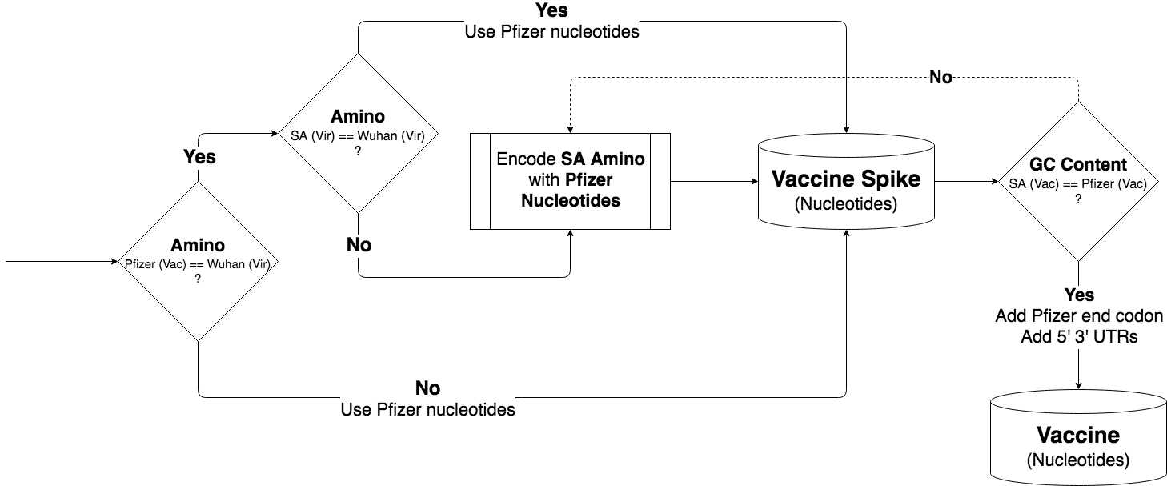
SA Variant - Create Vaccine
Identify Candidate Samples
Cull
(meta based)
Find Spike
Cull
(spike based)
Create Vaccine
General idea
Remain as close as possible to the the Pfizer vaccine
Where not possible due to mutation, best effort to resemble vaccine

Slide 32
SA Variant - Create Vaccine
Identify Candidate Samples
Cull
(meta based)
Find Spike
Cull
(spike based)
Create Vaccine
Whatever approach was used to get to the relevant samples, the same process was used to get the final vaccine:
Agreeing on a spike protein on the amino acids level by majority vote of the samples
Majority vote between the amino acids “winners” to decide what nucleotides should be used (this is actually only relevant to the nucleotides of the SA mutation, as all others will be “overridden” by the nucleotides of the vaccine for the Wuhan strain)
Replace SA spike nucleotides with Wuhan vaccine nucleotides everywhere the spike proteins agree on the amino level, and also on the intentional PP change of the vaccine - this removed the 1 nucleotide difference we observed between the methods

Slide 33
SA Variant - Create Vaccine
Identify Candidate Samples
Cull
(meta based)
Find Spike
Cull
(spike based)
Create Vaccine
If GC content is too high, fix it by using a mapping with less GC for some of the amino acids - this resulted in a difference in 2 nucleotides between the 2 methods
Add the end codon and 5’ and 3’ UTRs from the Pfizer vaccine

Slide 34
SA Variant - Final Vaccine
Identify Candidate Samples
Cull
(meta based)
Find Spike
Cull
(spike based)
Create Vaccine
GAGAAUAAACUAGUAUUCUUCUGGUCCCCACAGACUCAGAGAGAACCCGCCACCAUGUUCGUGUUCCUGGUGCUGCUGCCUCUGGUGUCCAGCCAGUGUGUGAACCUGACCACCAGAACACAGCUGCCUCCAGCCU
ACACCAACAGCUUUACCAGAGGCGUGUACUACCCCGACAAGGUGUUCAGAUCCAGCGUGCUGCACUCUACCCAGGACCUGUUCCUGCCUUUCUUCAGCAACGUGACCUGGUUCCACGCCAUCCACGUGUCCGGCAC
CAAUGGCACCAAGAGAUUCGCUAACCCCGUGCUGCCCUUCAACGACGGGGUGUACUUUGCCAGCACCGAGAAGUCCAACAUCAUCAGAGGCUGGAUCUUCGGCACCACACUGGACAGCAAGACCCAGAGCCUGCUG
AUCGUGAACAACGCCACCAACGUGGUCAUCAAAGUGUGCGAGUUCCAGUUCUGCAACGACCCCUUCCUGGGCGUCUACUACCACAAGAACAACAAGAGCUGGAUGGAAAGCGAGUUCCGGGUGUACAGCAGCGCCA
ACAACUGCACCUUCGAGUACGUGUCCCAGCCUUUCCUGAUGGACCUGGAAGGCAAGCAGGGCAACUUCAAGAACCUGCGCGAGUUCGUGUUUAAGAACAUCGACGGCUACUUCAAGAUCUACAGCAAGCACACCCC
UAUCAACCUCGUGCGGGGACUGCCUCAGGGCUUCUCUGCUCUGGAACCCCUGGUGGAUCUGCCCAUCGGCAUCAACAUCACCCGGUUUCAGACACUGCUGGCCCUGCACAGAAGCUACCUGACACCUGGCGAUAGC
AGCAGCGGAUGGACAGCUGGUGCCGCCGCUUACUAUGUGGGCUACCUGCAGCCUAGAACCUUCCUGCUGAAGUACAACGAGAACGGCACCAUCACCGACGCCGUGGAUUGUGCUCUGGAUCCUCUGAGCGAGACAA
AGUGCACCCUGAAGUCCUUCACCGUGGAAAAGGGCAUCUACCAGACCAGCAACUUCCGGGUGCAGCCCACCGAAUCCAUCGUGCGGUUCCCCAAUAUCACCAAUCUGUGCCCCUUCGGCGAGGUGUUCAAUGCCAC
CAGAUUCGCCUCUGUGUACGCCUGGAACCGGAAGCGGAUCAGCAAUUGCGUGGCCGACUACUCCGUGCUGUACAACUCCGCCAGCUUCAGCACCUUCAAGUGCUACGGCGUGUCCCCUACCAAGCUGAACGACCUG
UGCUUCACAAACGUGUACGCCGACAGCUUCGUGAUCCGGGGAGAUGAAGUGCGGCAGAUUGCCCCUGGACAGACAGGCAACAUCGCCGACUACAACUACAAGCUGCCCGACGACUUCACCGGCUGUGUGAUUGCCU
GGAACAGCAACAACCUGGACUCCAAAGUCGGCGGCAACUACAAUUACCUGUACCGGCUGUUCCGGAAGUCCAAUCUGAAGCCCUUCGAGCGGGACAUCUCCACCGAGAUCUAUCAGGCCGGCAGCACCCCUUGUAA
CGGCGUGAAGGGCUUCAACUGCUACUUCCCACUGCAGUCCUACGGCUUUCAGCCCACAUAUGGCGUGGGCUAUCAGCCCUACAGAGUGGUGGUGCUGAGCUUCGAACUGCUGCAUGCCCCUGCCACAGUGUGCGGC
CCUAAGAAAAGCACCAAUCUCGUGAAGAACAAAUGCGUGAACUUCAACUUCAACGGCCUGACCGGCACCGGCGUGCUGACAGAGAGCAACAAGAAGUUCCUGCCAUUCCAGCAGUUUGGCCGGGAUAUCGCCGAUA
CCACAGACGCCGUUAGAGAUCCCCAGACACUGGAAAUCCUGGACAUCACCCCUUGCAGCUUCGGCGGAGUGUCUGUGAUCACCCCUGGCACCAACACCAGCAAUCAGGUGGCAGUGCUGUACCAGGGAGUGAACUG
UACCGAAGUGCCCGUGGCCAUUCACGCCGAUCAGCUGACACCUACAUGGCGGGUGUACUCCACCGGCAGCAAUGUGUUUCAGACCAGAGCCGGCUGUCUGAUCGGAGCCGAGCACGUGAACAAUAGCUACGAGUGC
GACAUCCCCAUCGGCGCUGGAAUCUGCGCCAGCUACCAGACACAGACAAACAGCCCUCGGAGAGCCAGAAGCGUGGCCAGCCAGAGCAUCAUUGCCUACACAAUGUCUCUGGGCGUGGAGAACAGCGUGGCCUACU
CCAACAACUCUAUCGCUAUCCCCACCAACUUCACCAUCAGCGUGACCACAGAGAUCCUGCCUGUGUCCAUGACCAAGACCAGCGUGGACUGCACCAUGUACAUCUGCGGCGAUUCCACCGAGUGCUCCAACCUGCU
GCUGCAGUACGGCAGCUUCUGCACCCAGCUGAAUAGAGCCCUGACAGGGAUCGCCGUGGAACAGGACAAGAACACCCAAGAGGUGUUCGCCCAAGUGAAGCAGAUCUACAAGACCCCUCCUAUCAAGGACUUCGGC
GGCUUCAAUUUCAGCCAGAUUCUGCCCGAUCCUAGCAAGCCCAGCAAGCGGAGCUUCAUCGAGGACCUGCUGUUCAACAAAGUGACACUGGCCGACGCCGGCUUCAUCAAGCAGUAUGGCGAUUGUCUGGGCGACA
UUGCCGCCAGGGAUCUGAUUUGCGCCCAGAAGUUUAACGGACUGACAGUGCUGCCUCCUCUGCUGACCGAUGAGAUGAUCGCCCAGUACACAUCUGCCCUGCUGGCCGGCACAAUCACAAGCGGCUGGACAUUUGG
AGCAGGCGCCGCUCUGCAGAUCCCCUUUGCUAUGCAGAUGGCCUACCGGUUCAACGGCAUCGGAGUGACCCAGAAUGUGCUGUACGAGAACCAGAAGCUGAUCGCCAACCAGUUCAACAGCGCCAUCGGCAAGAUC
CAGGACAGCCUGAGCAGCACAGCAAGCGCCCUGGGAAAGCUGCAGGACGUGGUCAACCAGAAUGCCCAGGCACUGAACACCCUGGUCAAGCAGCUGUCCUCCAACUUCGGCGCCAUCAGCUCUGUGCUGAACGAUA
UCCUGAGCAGACUGGACCCUCCUGAGGCCGAGGUGCAGAUCGACAGACUGAUCACAGGCAGACUGCAGAGCCUCCAGACAUACGUGACCCAGCAGCUGAUCAGAGCCGCCGAGAUUAGAGCCUCUGCCAAUCUGGC
CGCCACCAAGAUGUCUGAGUGUGUGCUGGGCCAGAGCAAGAGAGUGGACUUUUGCGGCAAGGGCUACCACCUGAUGAGCUUCCCUCAGUCUGCCCCUCACGGCGUGGUGUUUCUGCACGUGACAUAUGUGCCCGCU
CAAGAGAAGAAUUUCACCACCGCUCCAGCCAUCUGCCACGACGGCAAAGCCCACUUUCCUAGAGAAGGCGUGUUCGUGUCCAACGGCACCCAUUGGUUCGUGACACAGCGGAACUUCUACGAGCCCCAGAUCAUCA
CCACCGACAACACCUUCGUGUCUGGCAACUGCGACGUCGUGAUCGGCAUUGUGAACAAUACCGUGUACGACCCUCUGCAGCCCGAGCUGGACAGCUUCAAAGAGGAACUGGACAAGUACUUUAAGAACCACACAAG
CCCCGACGUGGACCUGGGCGAUAUCAGCGGAAUCAAUGCCAGCGUCGUGAACAUCCAGAAAGAGAUCGACCGGCUGAACGAGGUGGCCAAGAAUCUGAACGAGAGCCUGAUCGACCUGCAAGAACUGGGGAAGUAC
GAGCAGUACAUCAAGUGGCCCUGGUACAUCUGGCUGGGCUUUAUCGCCGGACUGAUUGCCAUCGUGAUGGUCACAAUCAUGCUGUGUUGCAUGACCAGCUGCUGUAGCUGCCUGAAGGGCUGUUGUAGCUGUGGCA
GCUGCUGCAAGUUCGACGAGGACGAUUCUGAGCCCGUGCUGAAGGGCGUGAAACUGCACUACACAUGAUGACUCGAGCUGGUACUGCAUGCACGCAAUGCUAGCUGCCCCUUUCCCGUCCUGGGUACCCCGAGUCU
CCCCCGACCUCGGGUCCCAGGUAUGCUCCCACCUCCACCUGCCCCACUCACCACCUCUGCUAGUUCCAGACACCUCCCAAGCACGCAGCAAUGCAGCUCAAAACGCUUAGCCUAGCCACACCCCCACGGGAAACAG
CAGUGAUUAACCUUUAGCAAUAAACGAAAGUUUAACUAAGCUAUACUAACCCCAGGGUUGGUCAAUUUCGUGCCAGCCACACCCUGGAGCUAGCA

Slide 35
Questions?

Slide 36
Thank you!

